Slide 1
Warm up
Reflect C(-5, -3) over the y-axis.
Reflect D(2, -4) over the x-axis.
Reflect E(-12, 4) over y = -x.

Slide 2
Review Homework

Slide 3
Skills Check
Are you ready?

Slide 4
Rotations
Let’s discover the rules using the manipulatives.
Rotations Link

Slide 5

Degrees of Rotation
Let’s compare Clockwise and Counterclockwise
$$270°CCW$$
$$180°CCW$$
$$90°CCW$$

Slide 6
Rotate 90° Clockwise about the Origin (Same as 270° Counterclockwise)
Change the sign of x and switch the order

Slide 7
Rotate 90° clockwise about the origin

Slide 8
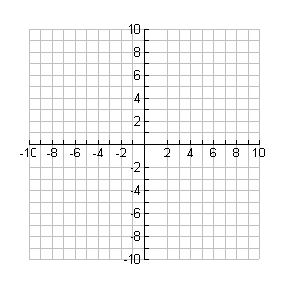
Rotate 90° clockwise about the origin

Slide 9
Rotate 90° Counterclockwise about the Origin (Same as 270° Clockwise)
Change the sign of y and switch the order

Slide 10
Rotate 90° counterclockwise about the origin

Slide 11
Rotate 90° counterclockwise about the origin

Slide 12
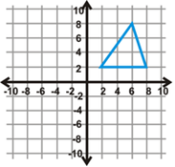
You try!
Rotate 270° Counterclockwise about the Origin:
Same as _________ Rule : _______________
$$90°CW$$

Slide 13
Rotate 180° about the Origin
ONLY Change the signs

Slide 14
Rotate 180° about the origin

Slide 15
Rotate 180° about the origin

Slide 16
Classwork
Rotations Practice Worksheet

Slide 17
Homework
Mixed Transformations HW Worksheet

