Slide 1
EOC REVIEW
Question of the Day

Slide 2
Questions over hw?

Slide 3
Circumference, Arc Length, Area, and Area of Sectors

Slide 4
Circumference
The distance around a circle

Slide 5
Circumference
Twinkle, Twinkle Little Star
Circumference Equals 2 pi r
or

Slide 6
2 Types of Answers
Rounded
Type the Pi button on your calculator
Toggle your answer
Do NOT write Pi in your answer
Exact
Pi will be in your answer

Slide 7
Find the EXACT circumference.
r = 14 feet
d = 15 miles

Slide 8
Ex 3 and 4: Find the circumference. Round to the nearest tenths.
33 yd
14.3 mm

Slide 9
Arc Length
The distance along the curved line making the arc (NOT a degree amount)
●

Slide 10
Arc Length

Slide 11
Ex 5. Find the Arc Length Round to the nearest hundredths
•
8m
70°

Slide 12
Ex 6. Find the exact Arc Length.
•

Slide 13
Ex 7. What happens to the arc length if the radius were to be doubled? Halved?
•

Slide 14
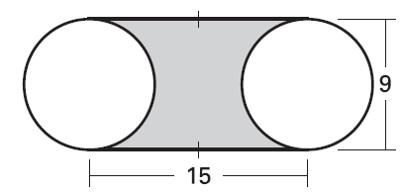
Ex 8. Find the perimeter of the region.

Slide 15
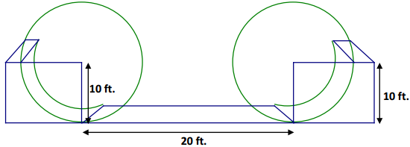
Ex 9. How far does the skater go from the top of one ramp to the top of the other?

Slide 16
Area of Circles
The amount of space occupied.
A = πr²
r
•

Slide 17
Find the EXACT area.
9. r = 29 feet
10. d = 44 miles

Slide 18
11 and 12 Find the area. Round to the nearest tenths.
53 cm
7.6 yd

Slide 19
Area of a Sector
the region bounded by two radii of the circle and their intercepted arc.

Slide 20
Area of a Sector

Slide 21
Example 13
Find the area of the sector to the nearest hundredths.
R
6 cm
60°
Q
A ≈ 18.85 cm²

Slide 22
Example 14
Find the exact area of the sector.
6 cm
7 cm
R
Q
120°

Slide 23
Example 15
Area of minor segment =
(Area of sector) – (Area of triangle)
R
Q
12 yd

Slide 24
Homework
Practice Worksheet

