Slide 1
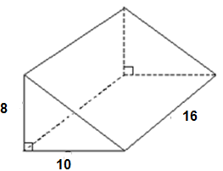
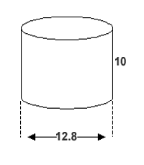
Warm up
Which solid has more volume?
Show work as evidence.
The cylinder has more volume.

Slide 2
Warm up #2
5 ft.

Slide 3
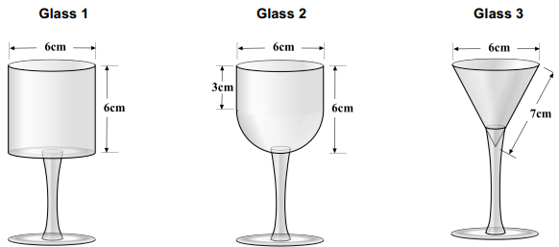
How much can each glass hold?
You pour, I choose!

Slide 4
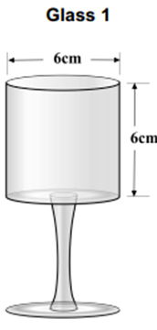
Glass 1

Slide 5
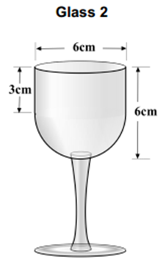
Glass 2

Slide 6
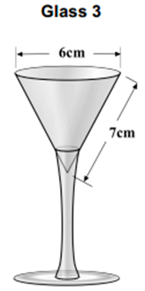
Glass 3

Slide 7
Homework Review

Slide 8
Skills Check

Slide 9
Cavalieri’s Principle

Slide 10
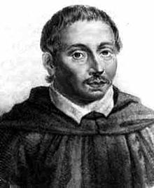
Bonaventura Cavalieri 1598 – 1647
Italian mathematician
Known for his work on the problems of:
Optics
Motion
Calculus
Introduction of logarithms

Slide 11
Cavalieri’s Principle
The volumes of two objects of the same height are equal if the areas of their corresponding cross sections are equal.

Slide 12
Cavalieri’s Principle Examples
These pieces maintain their SAME volume regardless of how they are moved.

Slide 13
Cavalieri’s Principle Examples
All heights are the same.
Since each cross sections’ area are congruent, all the volumes are equal.

Slide 14
Cavalieri’s Principle Examples
The same volume formula applies whether it’s a right prism or an oblique prism.
V = Bh

Slide 15
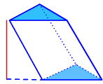
Example 1: Which solid has more volume? Use Cavalieri’s Principle.
20 in.
20 in.
4 in.
8 in.
6 in.
6 in.
The area of the cross sections are both 24in² and have the same height of 20, so the solids have the SAME volume.

Slide 16
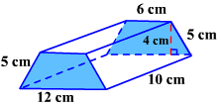
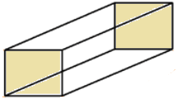
Example 2: Which solid has more volume? Use Cavalieri’s Principle.
6 cm
10 cm
6 cm
The area of the cross sections are both 36cm² and have the same height of 10, so the solids have the SAME volume.

Slide 17
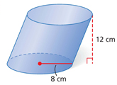
3. Find the volume to the nearest tenth.

Slide 18
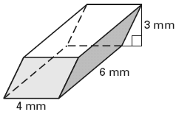
4. Find the volume to the nearest tenth.

Slide 19
Versa Tiles Worksheet
12 problems Find the Volume

Slide 20
Homework
Composites WS
Test Friday!

