Slide 1
Review
Unit #7 Circle Lengths & Volumes
with QR Code Answers

Slide 2
Q1 of 12
Solve for x.
x
3.2
•
3

Slide 3
Answer to #1

Slide 4
Q2 of 12
The edge length of a cone is multiplied by 7. Describe the effect on the volume.

Slide 5
Answer to #2

Slide 6
Q3 of 12
Solve for x.
152
9x – 1
41 – 5x
•

Slide 7
Answer to #3

Slide 8
Q4 of 12
Determine whether a tangent line is shown. Explain by showing work.
6
2.5
•
6.5

Slide 9
Answer to #4

Slide 10
Q5 of 12
Find the perimeter of the polygon.
9 cm
16 cm
•
•
•
•
8 cm
6 cm

Slide 11
Answer to #5

Slide 12
Q6 of 12
Solve for x.
20
8
•
6
x

Slide 13
Answer to #6

Slide 14
Q7 of 12
Solve for x and round to the nearest tenth.
20
•
11
x
13

Slide 15
Answer to #7

Slide 16
Q8 of 12
Solve for x and round to the nearest tenth.
x
•
7
15

Slide 17
Answer to #8

Slide 18
Q9 of 12
Solve for x and round to the nearest tenth.
3x – 4
•
x + 10

Slide 19
Answer to #9

Slide 20
Q10 of 12
The diameter of a sphere is 20 yd. Find the volume and round to the nearest hundredths.

Slide 21
Answer to #10

Slide 22
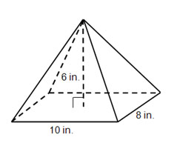
Q11 of 12
Find the volume of the pyramid.

Slide 23
Answer to #11

Slide 24
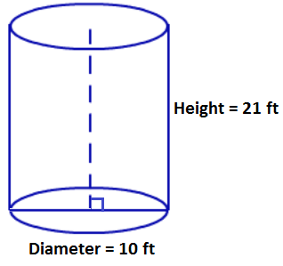
Q12 of 12
Find the exact volume of the cylinder.

Slide 25
Answer to #12

