Slide 1
Schedule for Rest of Semester
Monday | Tuesday | Wednesday | Thursday | Friday
4/29 EOC Info Unit 1 Review | 4/30 Unit 2/3 Review | 5/1 Unit 4/5 Review | 5/2 Unit 6/7 Review | 5/3 Unit 8 Mixed Review
5/6 EOC Day 1 | 5/7 EOC Day 2 | 5/8 Start Unit 9 – Final Test Info | 5/9 | 5/10
5/13 | 5/14 | 5/15 | 5/16 | 5/17
5/20 | 5/21 1ST/2ND FINALS – Unit 9 Test | 5/22 3RD/4TH FINALS – Unit 9 Test | 5/23 | 5/24

Slide 2
End Of Course Test

Slide 3
Monday 5/6
AND
Tuesday 5/7
Do NOT be Tardy or Absent!!!

Slide 4
3rd Block: You need to eat A lunch. If you forget, or are late, you will not be admitted to test!

Slide 5
Want to figure out your grade?
Current Grade*0.8 + Possible EOC grade*0.2
20%

Slide 6
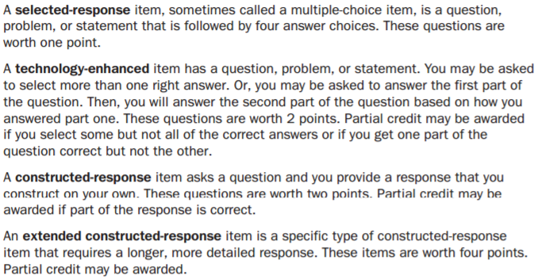
Types of Questions

Slide 7
Where is my test?!
Meet in the testing location. Don’t be late!
Ms. Wiggins | Media Center
Mrs. Mac | Rm 1114
Mrs. Smith | Rm 2411

Slide 8
What to do…
Sign onto computer.
Open DRC INSIGHT icon.
Select END-OF-COURSE (EOC)… Test Sign In.
Put phone on silent AND in your bag. Leave smart watches at home.
Take out pencil & calculator.
Place your bag in front of room.

Slide 11
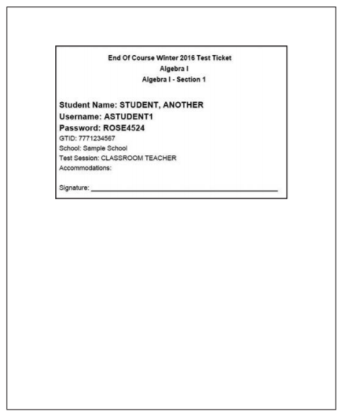

Slide 12
Monday:
Section 1,1: 10…NO calculator
Section 1,2: 27…WITH calculator
60 – 85 minutes TOTAL
37 questions TOTAL

Slide 13
Tuesday:
Section 2: 36…WITH calculator
60 – 85 minutes TOTAL
36 questions TOTAL
* Lunch… GO TO A LUNCH!

Slide 14
SEATING
& BAGS

Slide 15
PENCILS &
CALCULATOR

Slide 16
CELL PHONES AND SMART WATCHES

Slide 17
NAP TIME!

Slide 18
GSE Algebra I
Day 1 Review

Slide 19
1: Relationships Among Quantities
Key Ideas
Properties of Rational and Irrational Numbers
Reason Quantitatively and Use Units to Solve Problems
Interpret the Structure of Expressions

Slide 20
Rational vs. Irrational Numbers
Rational | Irrational
A real number that can be represented as a ratio p/q such that p and q are both integers and q does not equal zero. All rational numbers can be expressed as a decimal that stops or repeats. Ex: -0.5, 0, 7, 3/2, 0.266666666 | A real number that cannot be expressed as a ratio. Irrational numbers cannot be represented by decimals that stop or repeat. Ex: √3, , √5/2

Slide 21
Sum and Product of Rational and Irrational Numbers
The sum of an irrational number and a rational number is always irrational.
I + R = I
The product of a nonzero rational number and an irrational number is always irrational.
R x I = I
The sum or product of rational numbers is rational.
R + R = R R x R = R

Slide 22
Ex 2: Is the sum of ½ and √2 a rational or an irrational number?

Slide 23
Ex 3: Is the product of -0.5 and √3 a rational or an irrational number? Explain your reasoning.

Slide 24
Level of Accuracy
A quantity can be exact or approximate. When an approximate quantity is used, it is important that we consider its level of accuracy.
For example, a dosage of medicine would need to be very precise.
An example of a measurement that does not need to be very precise is the distance from your house to a local mall.

Slide 25
Unit of Measure
If you want to calculate the diameter of the sun, you would want to choose a very large unit of measure of length, such as miles or kilometers.
Conversion of units can require approximations.

Slide 26
Ex 4: Convert 309 yards to feet.

Slide 27
Ex 5: The cost, in dollars, of a single-story home can be approximated using the formula C = klw, where l is the approximate length of the home and w is the approximate width of the home. Find the units for the coefficient k.
k = C/lw or dollars per feet squared

Slide 28
Ex 6: Convert 45 miles per hour to feet per minute.

Slide 29
Ex 7: When Justin goes to work, he drives at an average speed of 65 miles per hour. It takes about 1 hour and 30 minutes for Justin to arrive at work. His car travels about 25 miles per gallon of gas. If gas costs $3.65 per gallon, how much money does Justin spend on gas to travel to work?
65mph * 1.5 hours =97.5 miles
97.5 ≈ 100 miles/25 = 4 gallons of gas
4 * $3.65 = $14.60

Slide 30
Important Tips
When referring to a quantity, include the unit or the items being counted whenever possible.
It is important to use appropriate units for measurements and to understand the relative sizes of units for the same measurement. You will need to know how to convert between units and how to round or limit the number of digits you use.
Use units to help determine if your answer is reasonable. For example, if a question asks for a weight and you find an answer in feet, check your answer.

Slide 31
Algebraic Expressions
An algebraic expression contains variables, numbers, and operation symbols.
A term in an algebraic expression can be a constant, variable, or constant multiplied by a variable or variables. Every term is separated by a plus sign.
A coefficient is the constant number that is multiplied by a variable in a term.
Factors are numbers multiplied together to get another number.
A common factor is a variable or number that terms can be divided by without a remainder.

Slide 32
Ex 8: Identify the terms, coefficients, and constants of the expression 5x² – 3x + 8.

